Slide 1

Metal Pandas
Project Order a Car
Kathryn Campo, Jana Grunewald, Kevin Mak, Odalys Martinez-Villa, Owen Rose, Nicholis Wright

Slide 2
Video URL
https://youtu.be/MwK8OBSgO2U

Slide 3
Summary
1 slide Summary: what technologies did you use? e.g. DB. What does not work? features, incomplete scenes, known bugs
Used: IntelliJ, SceneBuilder, H2 and SQL for the database.
Google map destinations do not store to the database.
Rating system does not compute properly.
If nothing is inputted into the fields on update it errors out without a warning to the user.
Profile picture does not store to database

Slide 4
Thank You
Any Questions?

Slide 5
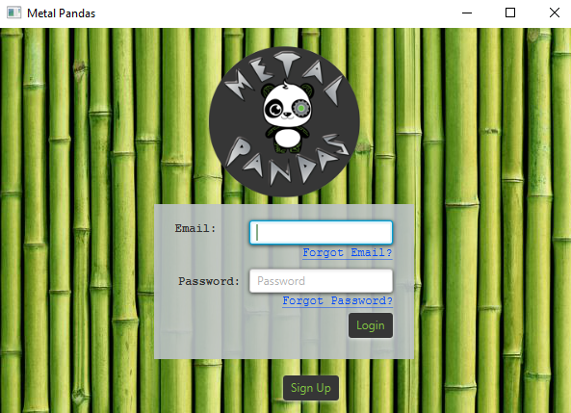
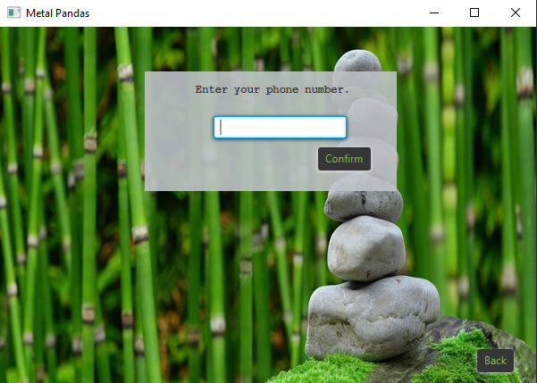
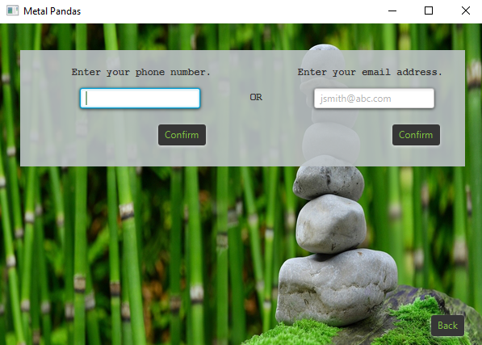
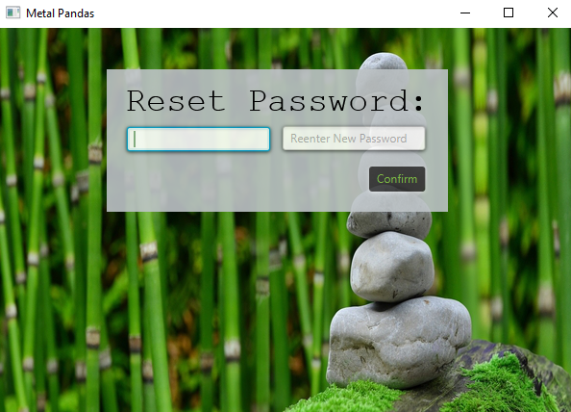
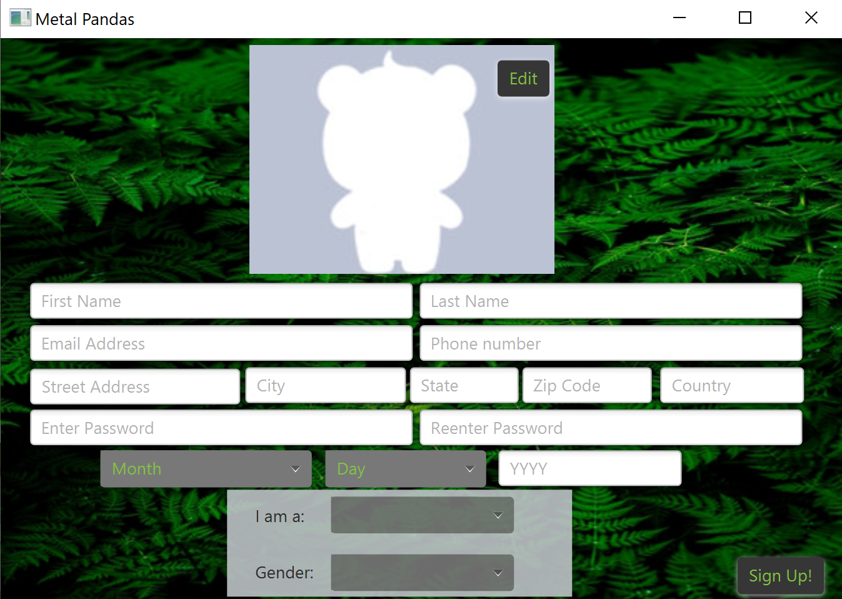
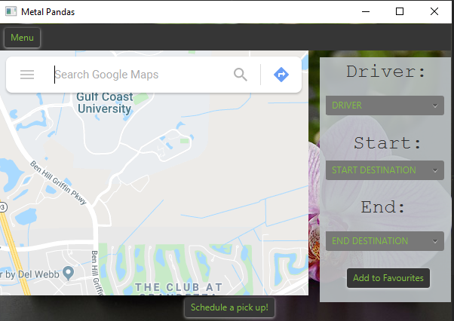

Slide 6
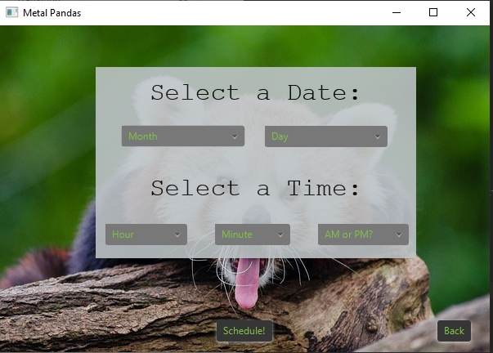
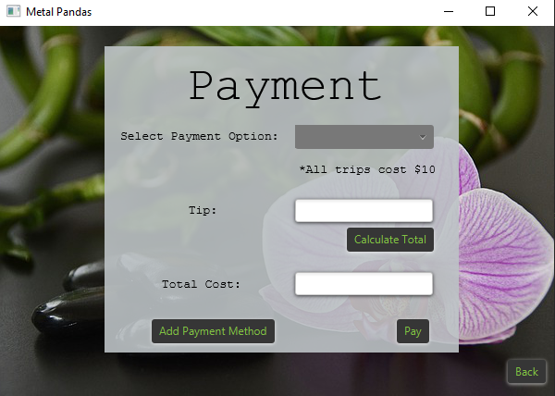
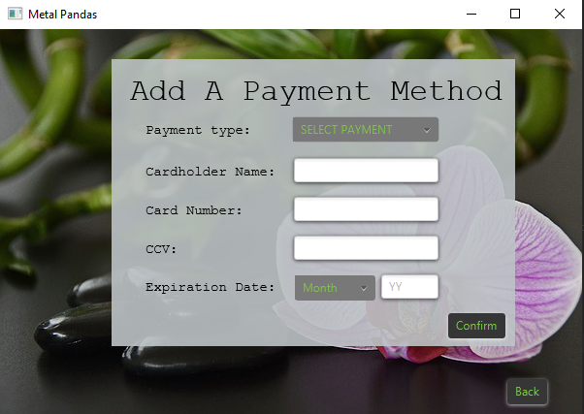
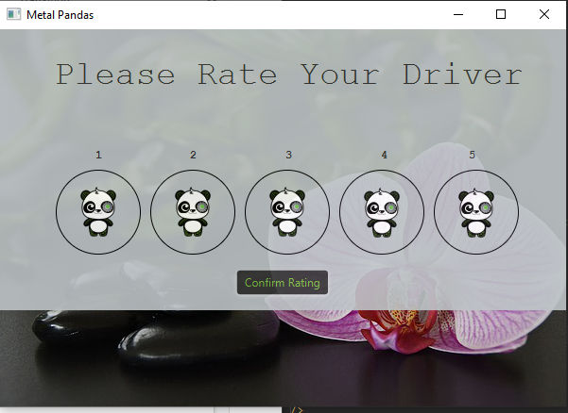
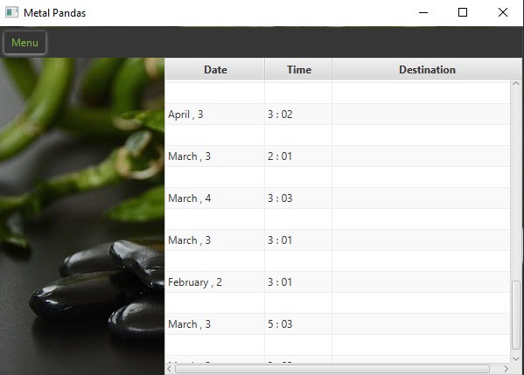
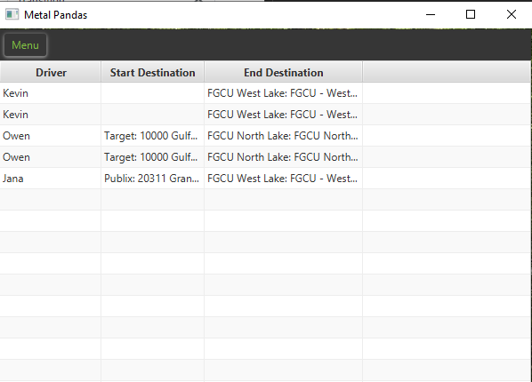

Slide 7
